Slide 1
Advanced Angular
Fundamentals
Lecture 1
By James(Jin) Wang
10/05/2019

Slide 2
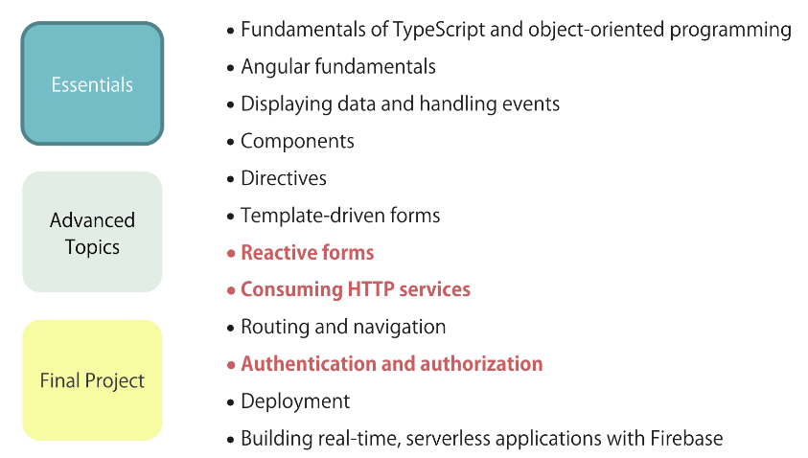
Big Picture

Slide 3
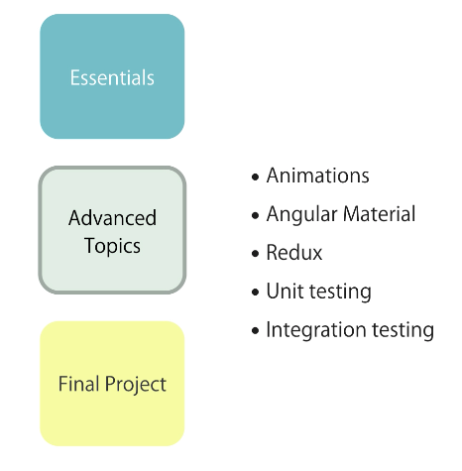
Big Picture

Slide 4
Outline
Components
Templates
Directives
Services

Slide 5
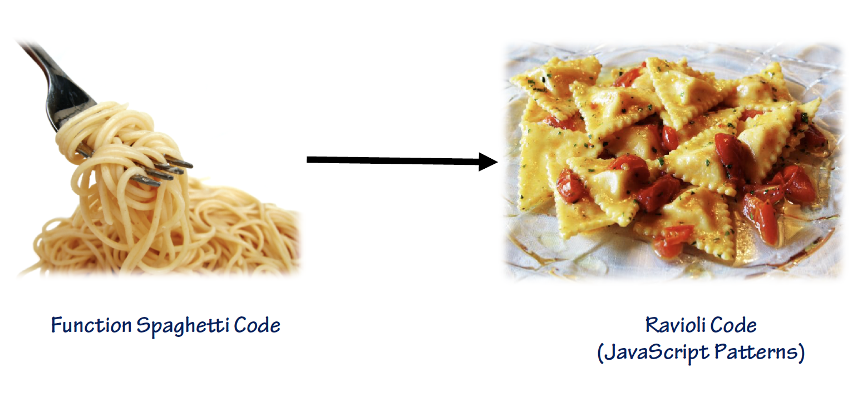
Why use TypeScript
  JavaScript Code Encapsulation:

Slide 6
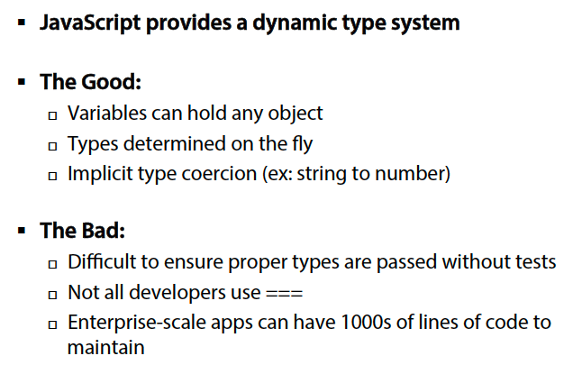
Why use TypeScript
  JavaScript Dynamic Types:

Slide 7

Why use TypeScript
  Migrating from Server-Side to Client-Side:
  Migrating from server-side apps to client-side apps can be challenging

Slide 8
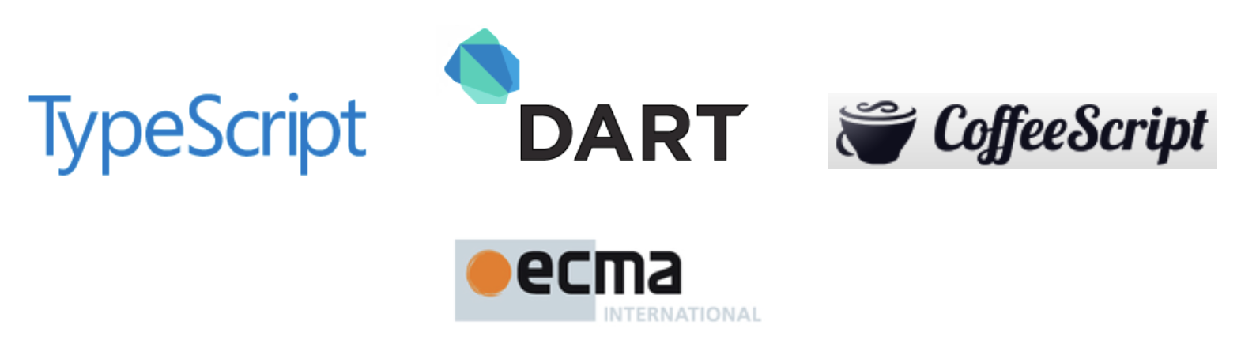
Why use TypeScript
  What are the Alternatives?
  Several TypeScript alternatives exist:
  Write pure JavaScript
  Apply JavaScript patterns
  CoffeeScript
  Dart

Slide 9
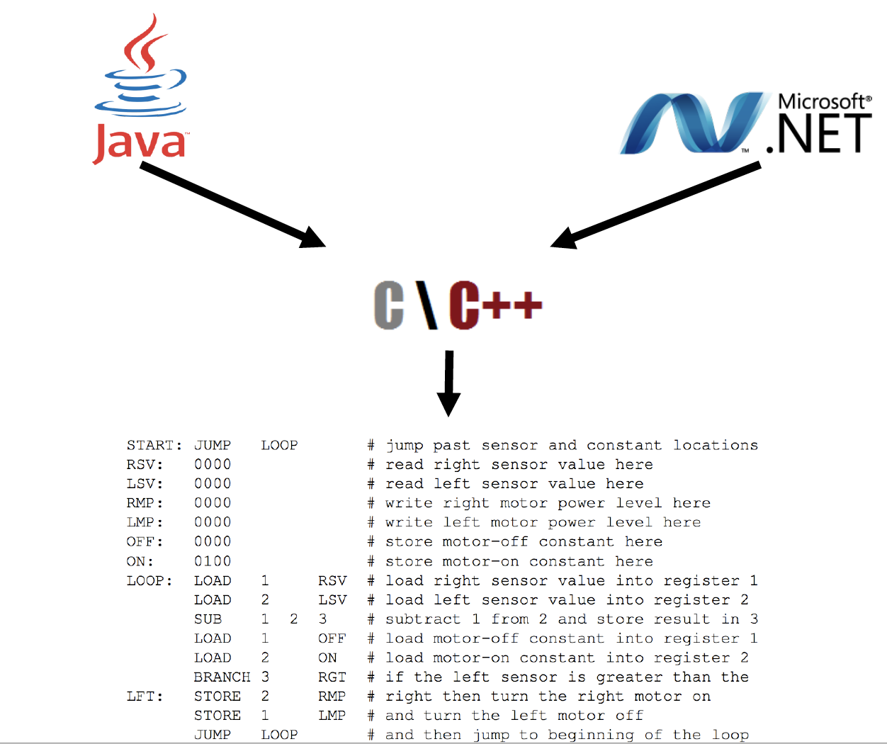
Why use TypeScript
  Should we Simply Write Plain JavaScript?

Slide 10

TypeScript Features
  What is TypeScript?

Slide 11
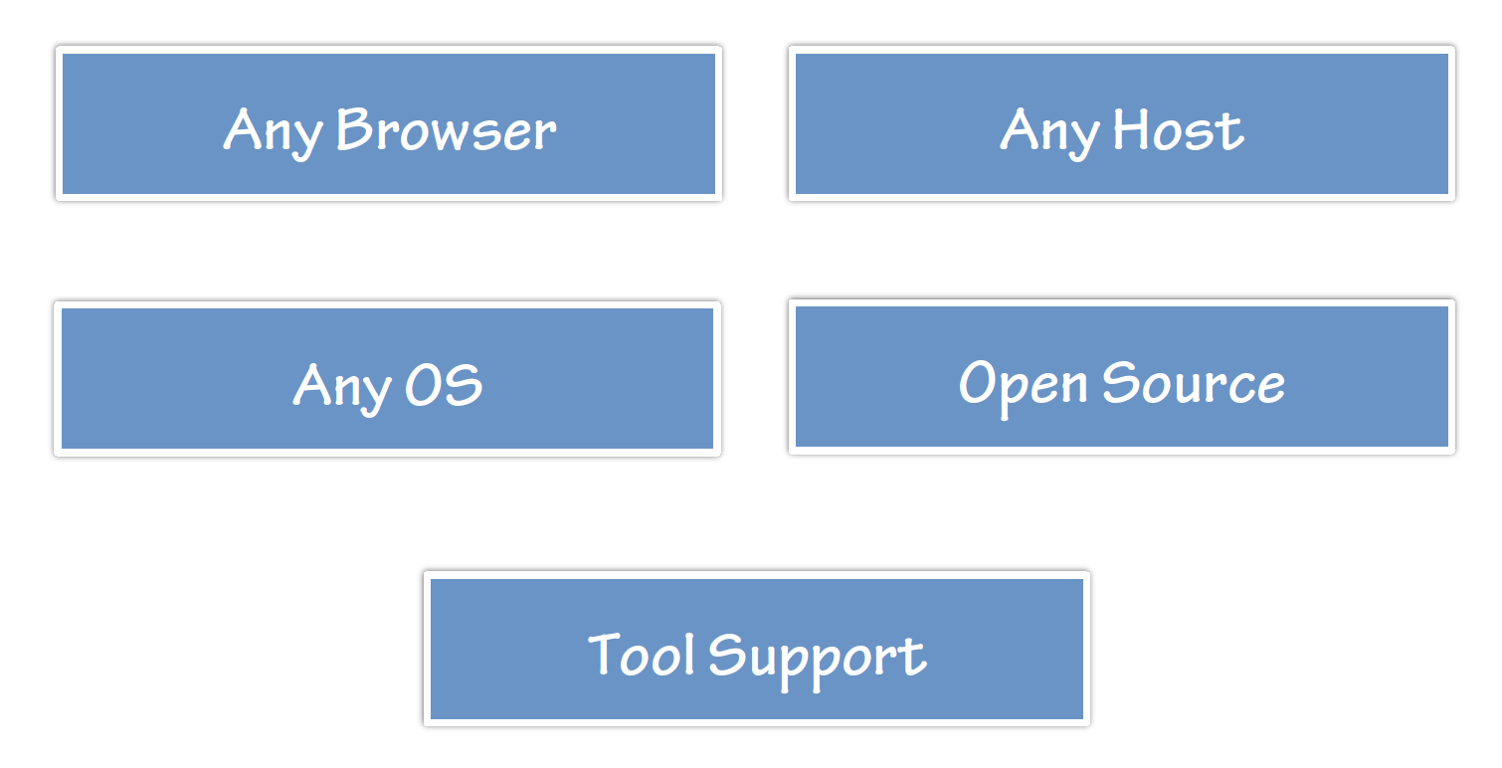
TypeScript Features
  Flexible Options:

Slide 12
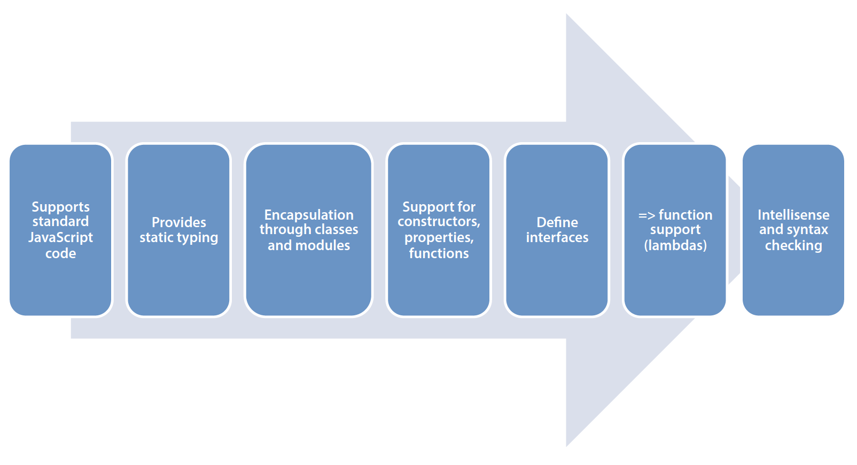
TypeScript Features
  Key TypeScript Features:

Slide 13
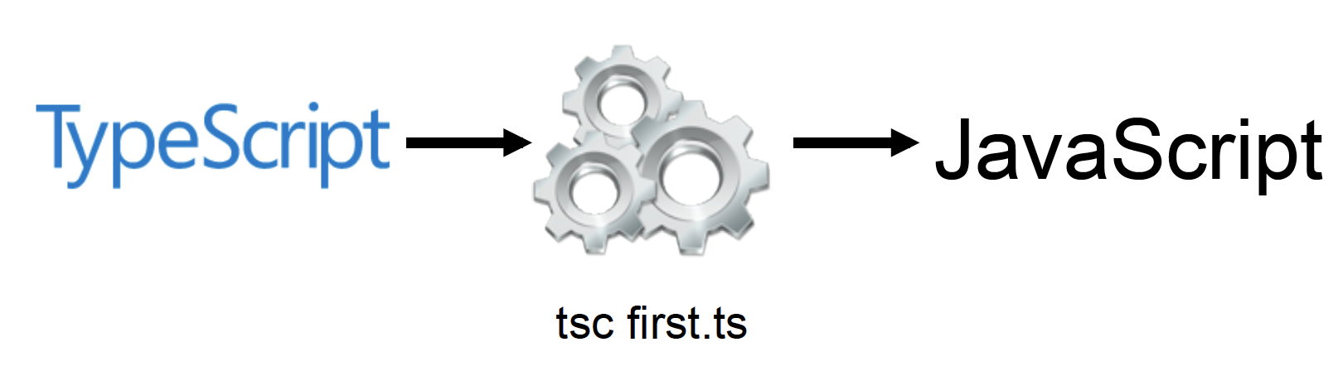
TypeScript Features
  TypeScript Compiler:

Slide 14
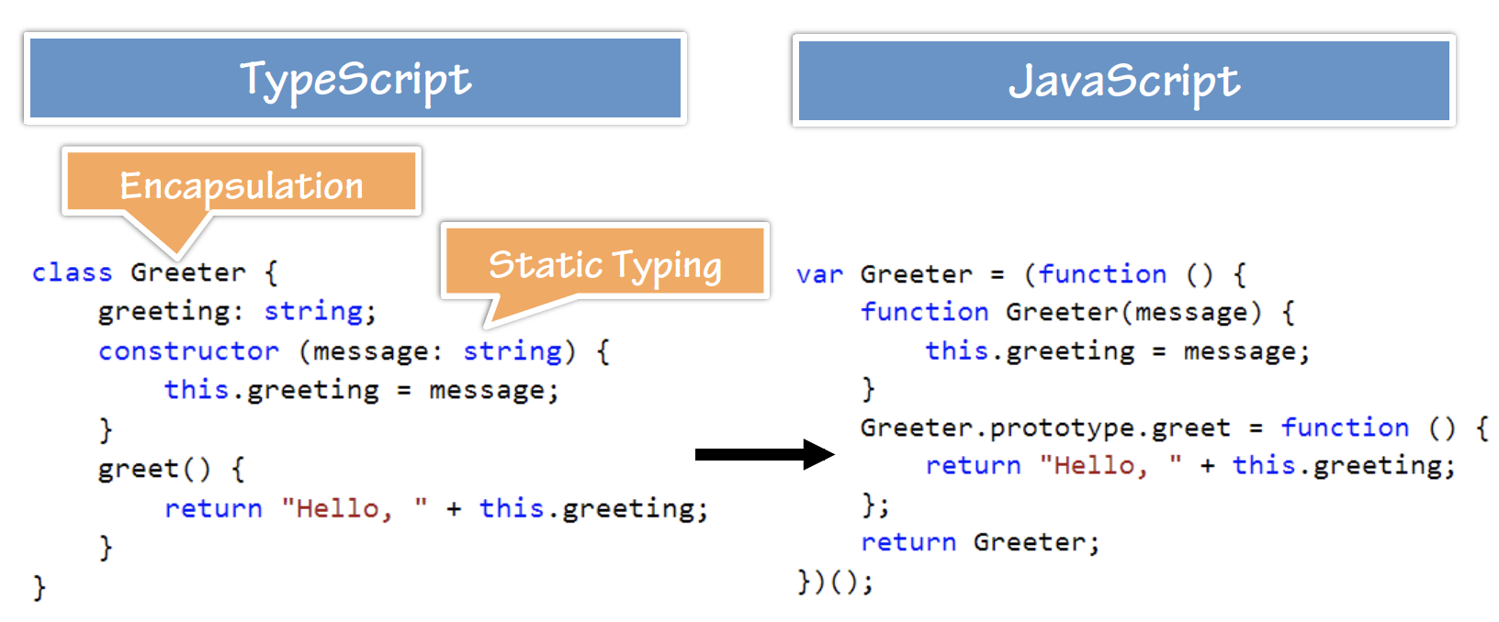
TypeScript Features
  TypeScript -> JavaScript:
  Demo: Greeter

Slide 15
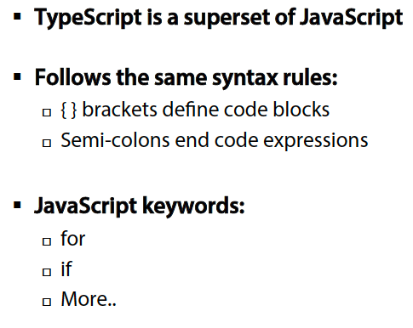
TypeScript Syntax, Keywords and Code Hierarchy
  TypeScript Syntax Rules:

Slide 16
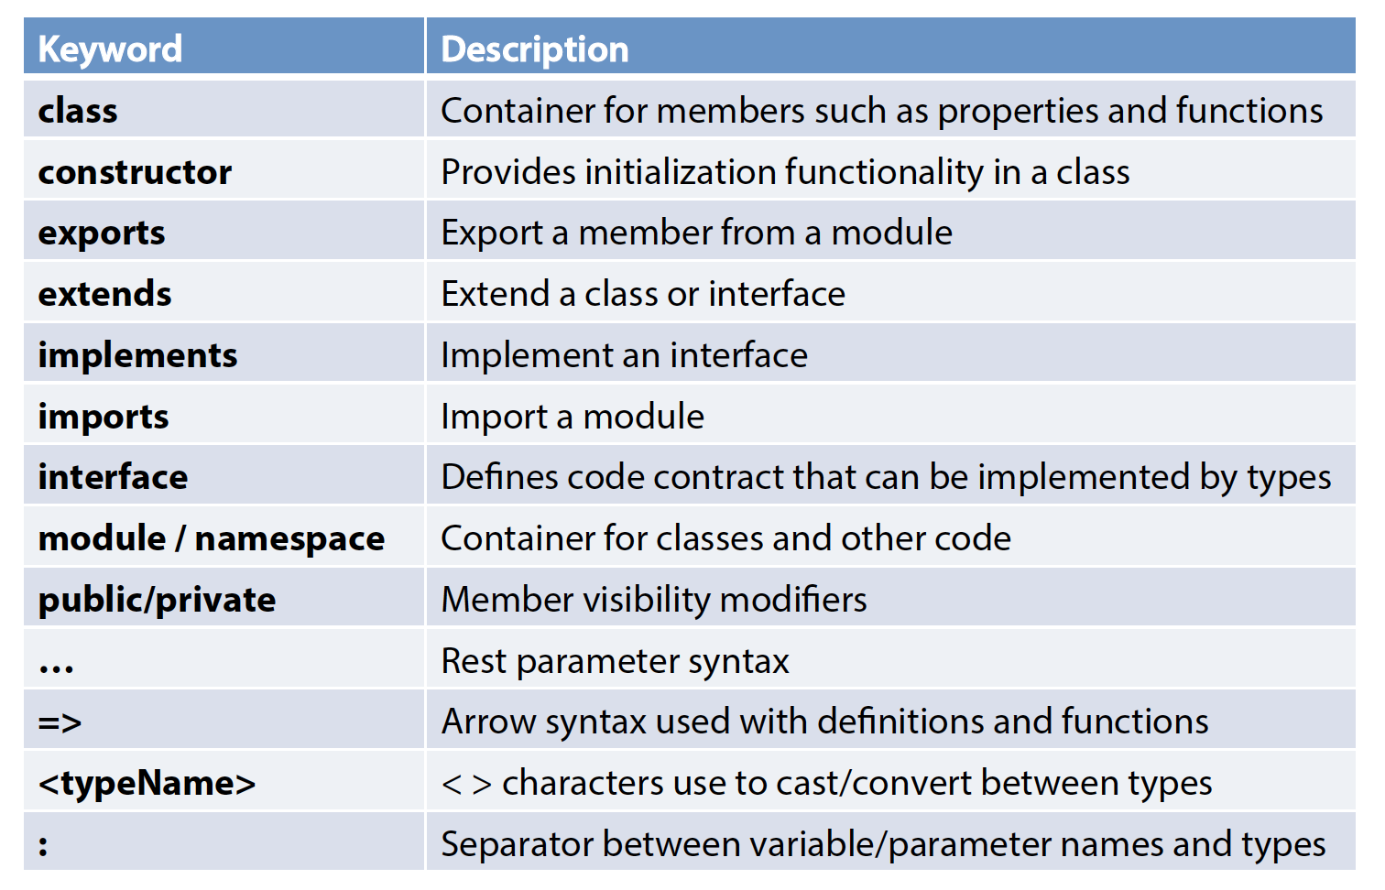
TypeScript Syntax, Keywords and Code Hierarchy
  Important Keywords and Operators:

Slide 17
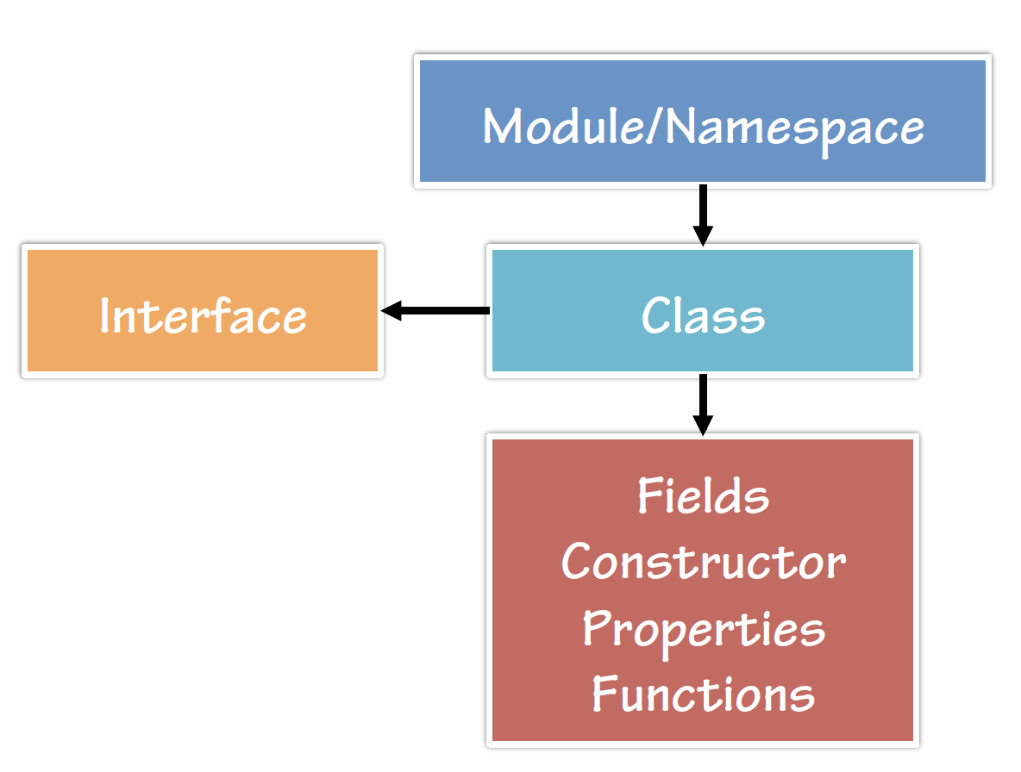
TypeScript Syntax, Keywords and Code Hierarchy
  Code Hierarchy:

Slide 18
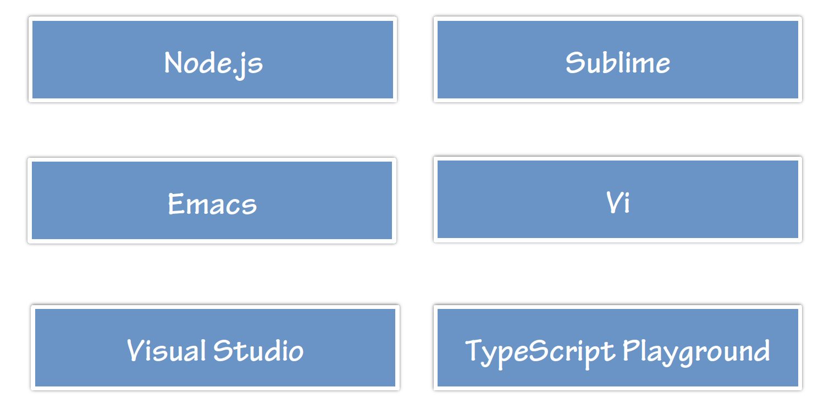
Tooling/Framework Options
  Tool/Framework Support:

Slide 19
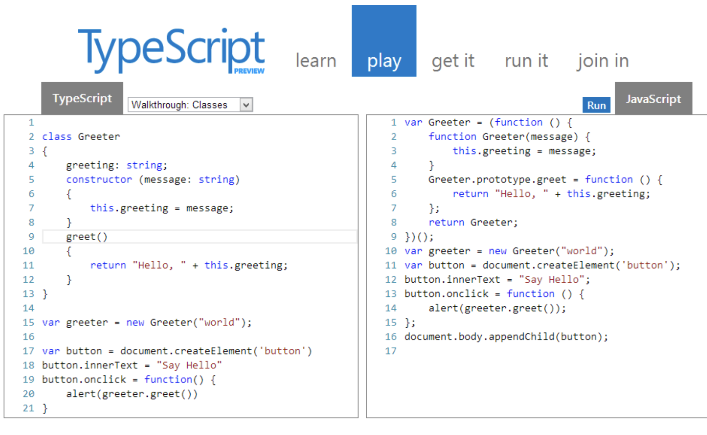
Tooling/Framework Options
  Demo: HelloWorld

Slide 20
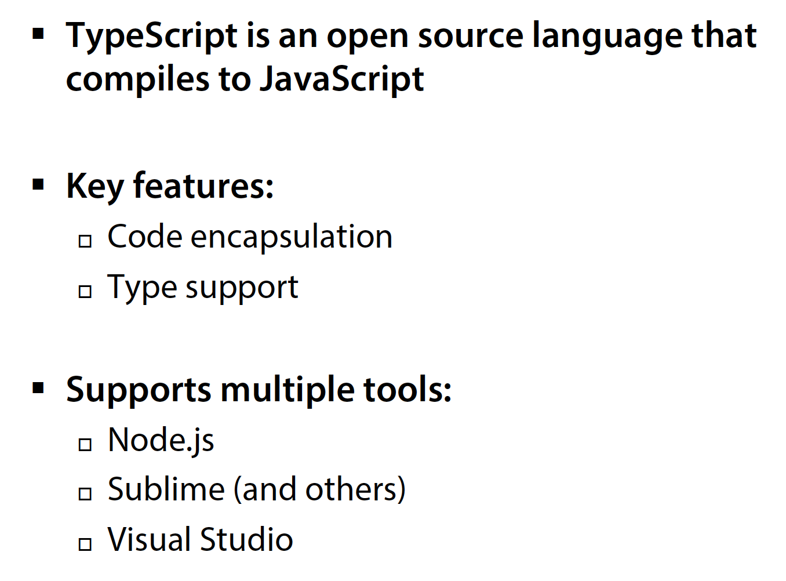
Summary

